Slide 1
Intro to Splunk
By Moshe Kaplan

Slide 2
Agenda
What is Splunk?
How can Splunk be used to analyze data?
Searching
Alerting
Dashboards

Slide 3
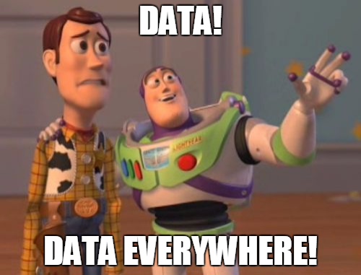
Notes:
This is our problem

Slide 4
What is Splunk?
Splunk is a solution for capturing, indexing, and analyzing real-time data.
Splunk indexes many data sources:
Web traffic
Emails
System Logs
Antivirus alerts
Notes:
Big data refers to datasets so large that they cannot be reasonably analyzed through traditional software programs.

Slide 5
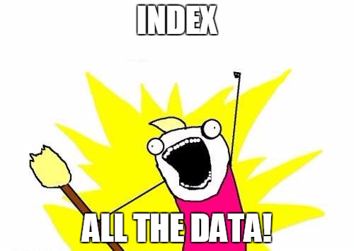
Says every Splunk engineer

Slide 6
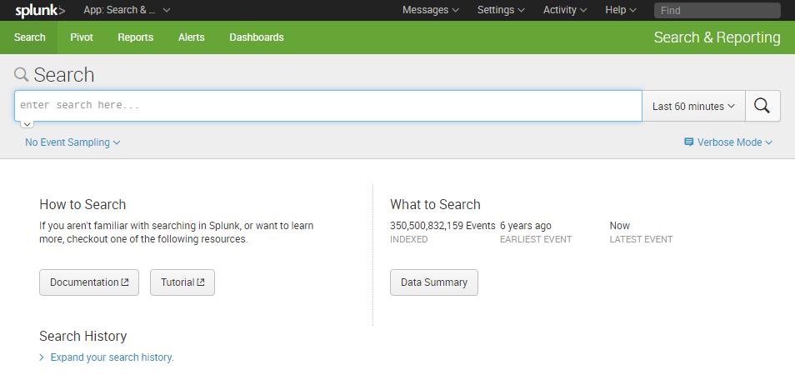
Splunk Main View

Slide 7
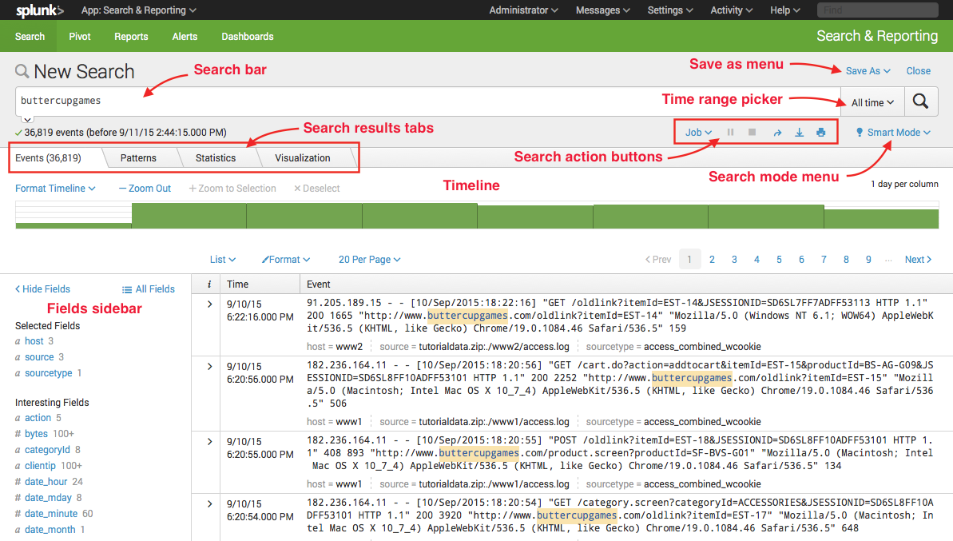

Slide 8
Splunk Search Syntax
Phrases:
Text in quotes
Example: “email error” returns every event which contains “email error”.
Not case sensitive
Fields:
Allows searching based on a specific field
Example: src_ip=“192.168.1.1”
Field names (not values) must have correct case
Wildcards:
Allows searching for patterns
Example: src_ip=“10.*.1.1”
* matches any character, any amount of them.

Slide 9
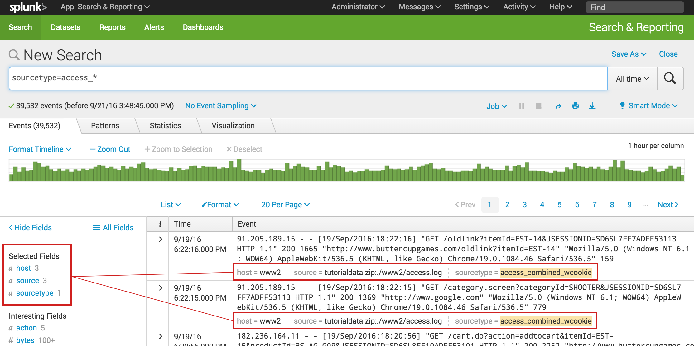
Splunk Data Representation
Notes:
Entries are represented as events, with each row representing a single event.
Each value for an event is represented with a single column.

Slide 10
Splunk Search Syntax - Comparisons
Booleans:
AND, OR, and NOT
Example: (“web” AND “error”) OR http_status=404
Must be uppercase
Search conditions always have an implicit AND:
“web” “error” is equivalent to “web” AND “error”
Comparison Operators:
Operators: =, !=, <, <=, >, >=
Example: http_status!=200

Slide 11
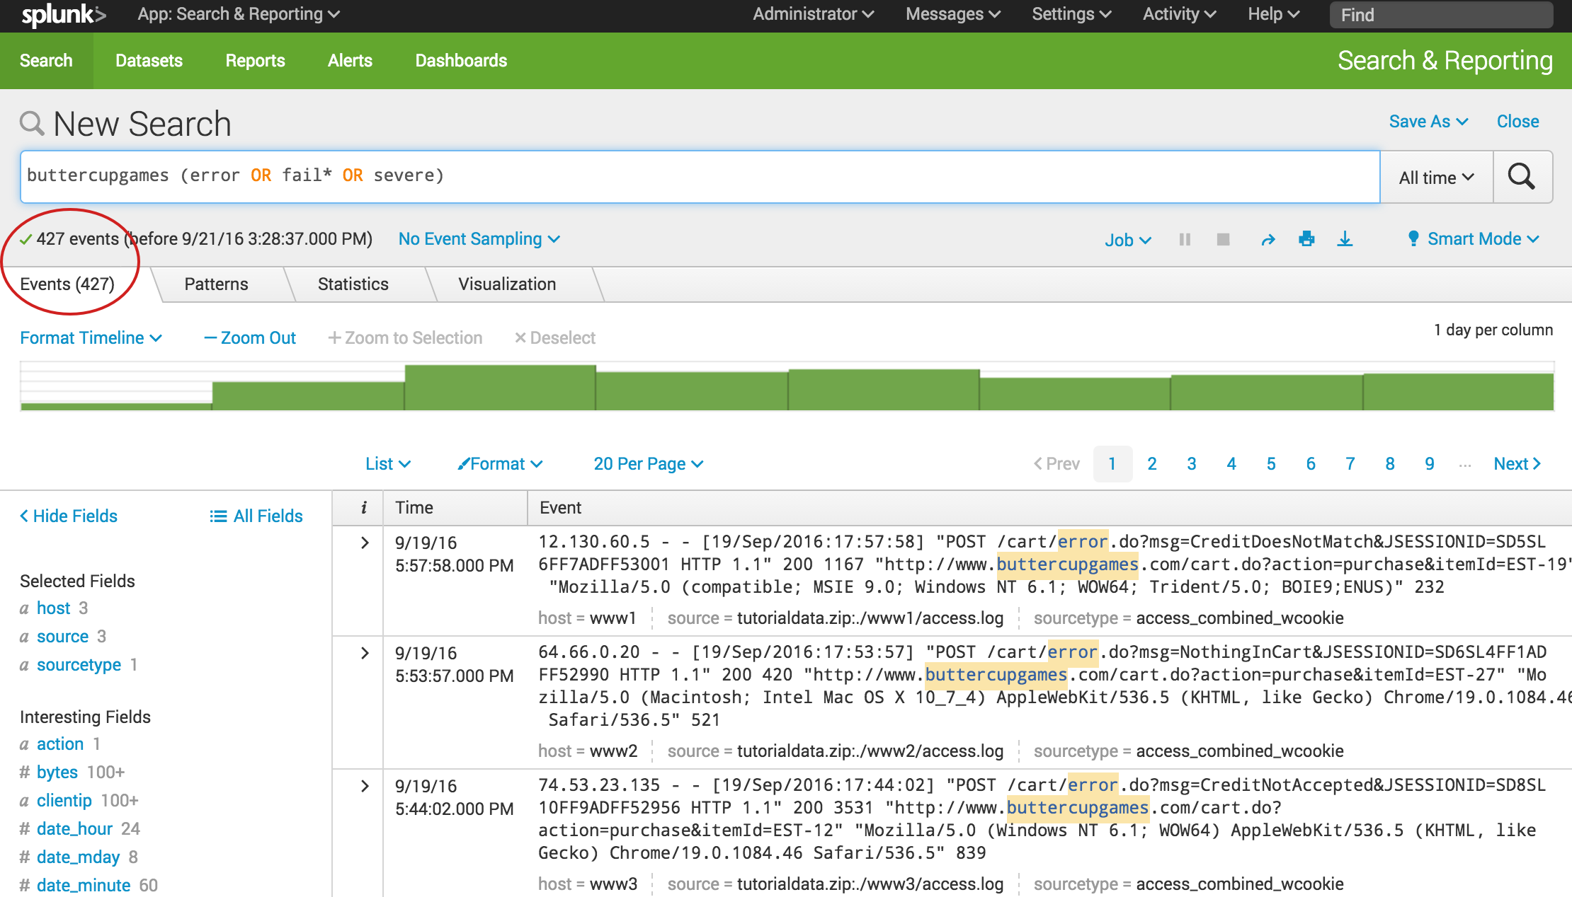
Splunk Search with Booleans

Slide 12
Subsearches
A subsearch is a search within a search.
Results from the subsearch are used as an argument to the outer search.
Subsearches are specified in square brackets []
Example:
Websites visited by users who visited google.com
domain=* [search domain=google.com| fields username]

Slide 13
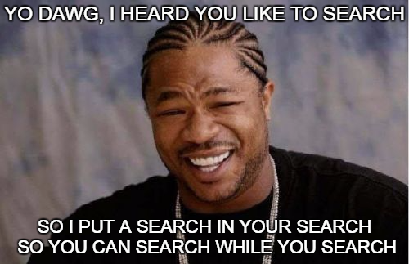
Subsearches

Slide 14
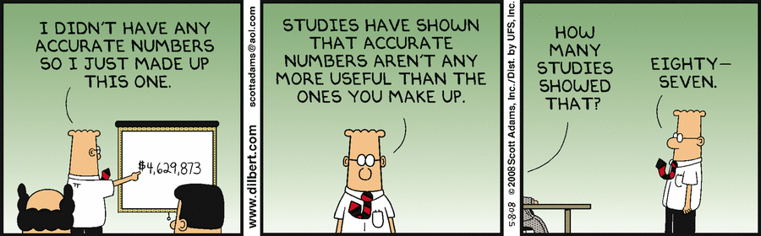
Statistics

Slide 15
Stats Command
The stats command lets you calculate statistics from search results.
“my phrase” | stats
Common functions:
count : count of events
distinct_count : count of unique field values
sum : sum of events
avg : average of events
Example 1: Total number of domains visited:
domain=* | stats count(domain)
This is just a single number (like 5,000)
Example 2: Number of times each domain was visited:
domain=* | stats count(domain) BY domain
This is two columns: the domain and how many times it was visited

Slide 16
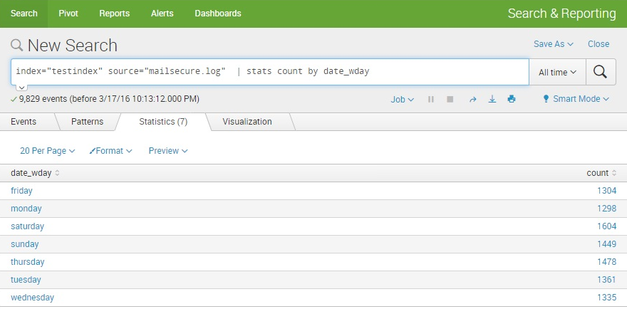
Stats Command

Slide 17
Alerting
Splunk supports creating alerts to monitor for specific events.
Searches on a hourly/daily/weekly/ schedule.
Performs an action when the search exceeds some threshold. Examples:
More than 5 failed logins for a single username
User visits a suspicious URL

Slide 18
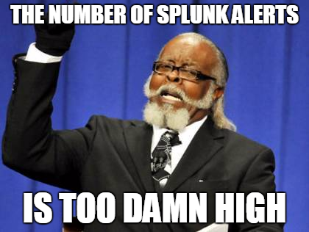
Alert Throttling
Notes:
Supports throttling, so a buggy alert won’t fire many times in a short time period.

Slide 19
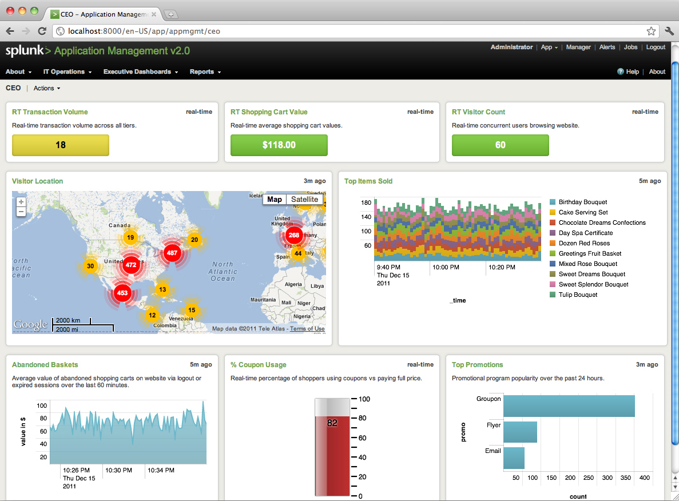
Dashboards
Notes:
Displays output of existing searches

Slide 20
References
Splunk Search Tutorial: https://docs.splunk.com/Documentation/Splunk/6.5.0/SearchTutorial/WelcometotheSearchTutorial
Creating Splunk Dashboards: https://vimeo.com/137428442

